Slide 1
Computer Systems:
A Programmer’s Perspective
程序设计与计算机系统
Lecture 5
Code Optimization
November 12, 2020
Wu junmin (jmwu@ustc.edu.cn)

Slide 2
Today
Overview
Generally Useful Optimizations
  Code motion/precomputation
  Strength reduction
  Sharing of common subexpressions
  Removing unnecessary procedure calls
Optimization Blockers
  Procedure calls
  Memory aliasing
Exploiting Instruction-Level Parallelism
Dealing with Conditionals
Code Profiling & Tuning

Slide 3
Performance Realities
There’s more to performance than asymptotic complexity
Constant factors matter too!
  Easily see 10:1 performance range depending on how code is written
  Must optimize at multiple levels:
    algorithm, data representations, procedures, and loops
Must understand system to optimize performance
  How programs are compiled and executed
  How modern processors + memory systems operate
  How to measure program performance and identify bottlenecks
  How to improve performance without destroying code modularity and generality

Slide 4
Optimizing Compilers
Provide efficient mapping of program to machine
  register allocation
  code selection and ordering (scheduling)
  dead code elimination
  eliminating minor inefficiencies
Don’t (usually) improve asymptotic efficiency
  up to programmer to select best overall algorithm
  big-O savings are (often) more important than constant factors
    but constant factors also matter
Have difficulty overcoming “optimization blockers”
  potential memory aliasing
  potential procedure side-effects

Slide 5
Limitations of Optimizing Compilers
Operate under fundamental constraint
  Must not cause any change in program behavior
    Except, possibly when program making use of nonstandard language features
  Often prevents it from making optimizations that would only affect behavior under pathological conditions.
Behavior that may be obvious to the programmer can be obfuscated by languages and coding styles
  e.g., Data ranges may be more limited than variable types suggest
Most analysis is performed only within procedures
  Whole-program analysis is too expensive in most cases
  Newer versions of GCC do interprocedural analysis within individual files
    But, not between code in different files
Most analysis is based only on static information
  Compiler has difficulty anticipating run-time inputs
When in doubt, the compiler must be conservative

Slide 6
Generally Useful Optimizations
Optimizations that you or the compiler should do regardless of processor / compiler
Code Motion
  Reduce frequency with which computation performed
    If it will always produce same result
    Especially moving code out of loop
void set_row(double *a, double *b,
long i, long n)
{
long j;
for (j = 0; j < n; j++)
a[n*i+j] = b[j];
}
long j;
int ni = n*i;
for (j = 0; j < n; j++)
a[ni+j] = b[j];

Slide 7
Compiler-Generated Code Motion (-O1)
void set_row(double *a, double *b,
long i, long n)
{
long j;
for (j = 0; j < n; j++)
a[n*i+j] = b[j];
}
long j;
long ni = n*i;
double *rowp = a+ni;
for (j = 0; j < n; j++)
*rowp++ = b[j];
set_row:
testq %rcx, %rcx # Test n
jle .L1 # If 0, goto done
imulq %rcx, %rdx # ni = n*i
leaq (%rdi,%rdx,8), %rdx # rowp = A + ni*8
movl $0, %eax # j = 0
.L3: # loop:
movsd (%rsi,%rax,8), %xmm0 # t = b[j]
movsd %xmm0, (%rdx,%rax,8) # M[A+ni*8 + j*8] = t
addq $1, %rax # j++
cmpq %rcx, %rax # j:n
jne .L3 # if !=, goto loop
.L1: # done:
rep ; ret

Slide 8
Reduction in Strength
  Replace costly operation with simpler one
  Shift, add instead of multiply or divide
    16*x --> x << 4
    Utility machine dependent
    Depends on cost of multiply or divide instruction
      On Intel Nehalem, integer multiply requires 3 CPU cycles
  Recognize sequence of products
int ni = 0;
for (i = 0; i < n; i++) {
for (j = 0; j < n; j++)
a[ni + j] = b[j];
ni += n;
}
for (i = 0; i < n; i++) {
int ni = n*i;
for (j = 0; j < n; j++)
a[ni + j] = b[j];
}

Slide 9
Share Common Subexpressions
  Reuse portions of expressions
  GCC will do this with –O1
/* Sum neighbors of i,j */
up = val[(i-1)*n + j ];
down = val[(i+1)*n + j ];
left = val[i*n + j-1];
right = val[i*n + j+1];
sum = up + down + left + right;
long inj = i*n + j;
up = val[inj - n];
down = val[inj + n];
left = val[inj - 1];
right = val[inj + 1];
sum = up + down + left + right;
3 multiplications: i*n, (i–1)*n, (i+1)*n
1 multiplication: i*n
leaq 1(%rsi), %rax # i+1
leaq -1(%rsi), %r8 # i-1
imulq %rcx, %rsi # i*n
imulq %rcx, %rax # (i+1)*n
imulq %rcx, %r8 # (i-1)*n
addq %rdx, %rsi # i*n+j
addq %rdx, %rax # (i+1)*n+j
addq %rdx, %r8 # (i-1)*n+j
imulq %rcx, %rsi # i*n
addq %rdx, %rsi # i*n+j
movq %rsi, %rax # i*n+j
subq %rcx, %rax # i*n+j-n
leaq (%rsi,%rcx), %rcx # i*n+j+n

Slide 10
Optimization Blocker #1: Procedure Calls
Procedure to Convert String to Lower Case
  Extracted from 213 lab submissions, Fall, 1998
void lower(char *s)
{
size_t i;
for (i = 0; i < strlen(s); i++)
if (s[i] >= 'A' && s[i] <= 'Z')
s[i] -= ('A' - 'a');
}

Slide 11
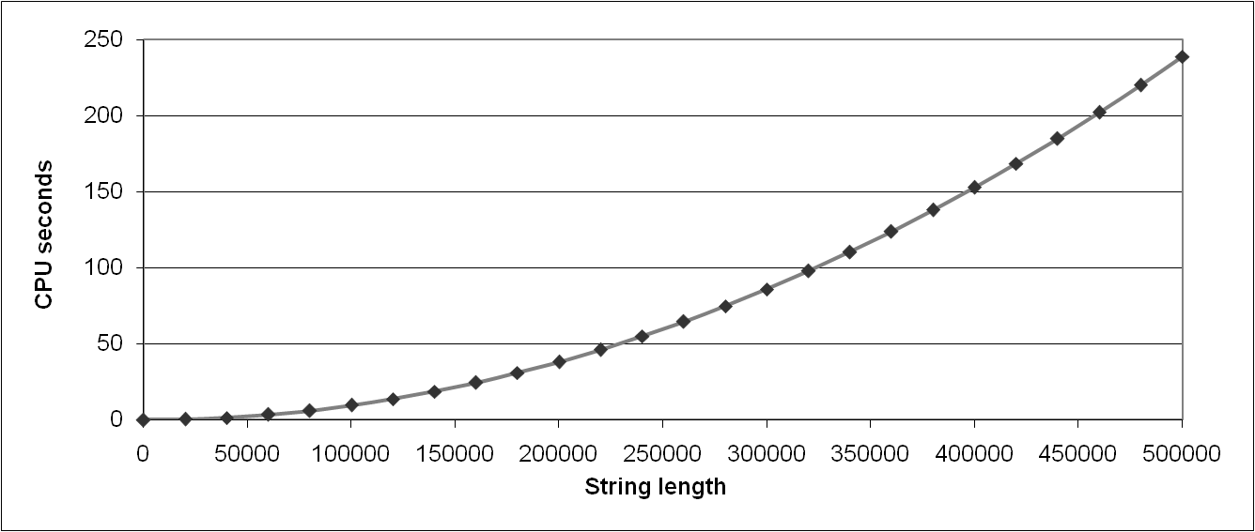
Lower Case Conversion Performance
  Time quadruples when double string length
  Quadratic performance
lower1

Slide 12
Convert Loop To Goto Form
void lower(char *s)
{
size_t i = 0;
if (i >= strlen(s))
goto done;
loop:
if (s[i] >= 'A' && s[i] <= 'Z')
s[i] -= ('A' - 'a');
i++;
if (i < strlen(s))
goto loop;
done:
}
  strlen executed every iteration

Slide 13
Calling Strlen
/* My version of strlen */
size_t strlen(const char *s)
{
size_t length = 0;
while (*s != '\0') {
s++;
length++;
}
return length;
}
Strlen performance
  Only way to determine length of string is to scan its entire length, looking for null character.
Overall performance, string of length N
  N calls to strlen
  Require times N
  Overall O(N²) performance

Slide 14
Improving Performance
void lower(char *s)
{
size_t i;
size_t len = strlen(s);
for (i = 0; i < len; i++)
if (s[i] >= 'A' && s[i] <= 'Z')
s[i] -= ('A' - 'a');
}
  Move call to strlen outside of loop
  Since result does not change from one iteration to another
  Form of code motion

Slide 15
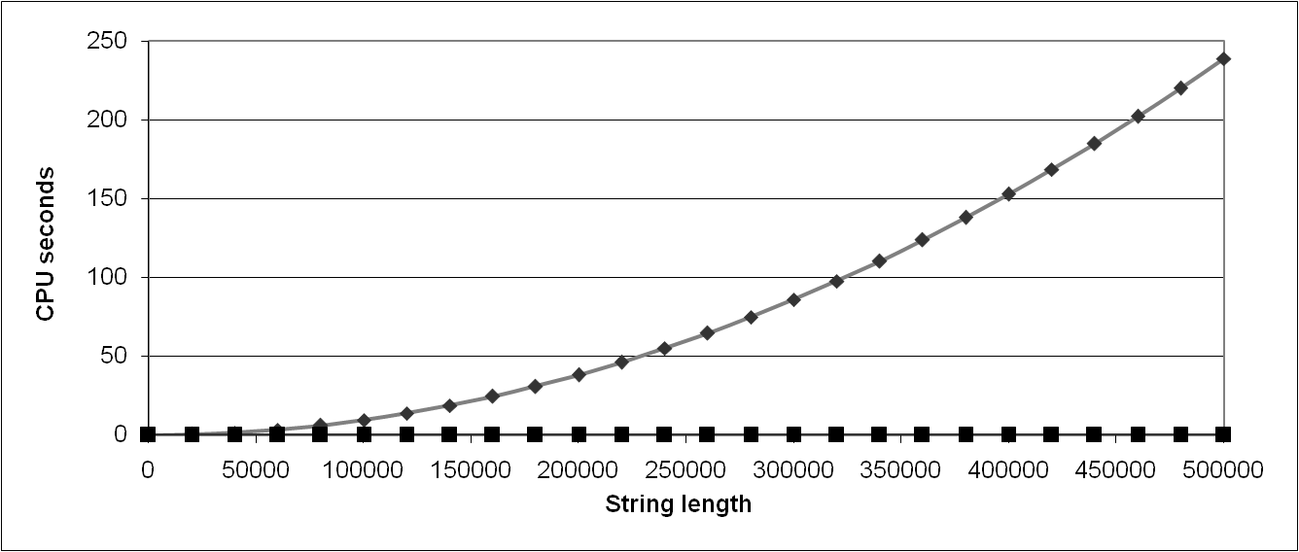
Lower Case Conversion Performance
  Time doubles when double string length
  Linear performance of lower2
lower1
lower2

Slide 16
Optimization Blocker: Procedure Calls
Why couldn’t compiler move strlen out of inner loop?
  Procedure may have side effects
    Alters global state each time called
  Function may not return same value for given arguments
    Depends on other parts of global state
    Procedure lower could interact with strlen
Warning:
  Compiler treats procedure call as a black box
  Weak optimizations near them
Remedies:
  Use of inline functions
    GCC does this with –O1
      Within single file
  Do your own code motion
size_t lencnt = 0;
size_t strlen(const char *s)
{
size_t length = 0;
while (*s != '\0') {
s++; length++;
}
lencnt += length;
return length;
}

Slide 17
Memory Matters
/* Sum rows is of n X n matrix a
and store in vector b */
void sum_rows1(double *a, double *b, long n) {
long i, j;
for (i = 0; i < n; i++) {
b[i] = 0;
for (j = 0; j < n; j++)
b[i] += a[i*n + j];
}
}
# sum_rows1 inner loop
.L4:
movsd (%rsi,%rax,8), %xmm0 # FP load
addsd (%rdi), %xmm0 # FP add
movsd %xmm0, (%rsi,%rax,8) # FP store
addq $8, %rdi
cmpq %rcx, %rdi
jne .L4
  Code updates b[i] on every iteration
  Why couldn’t compiler optimize this away?

Slide 18
Memory Aliasing
/* Sum rows is of n X n matrix a
and store in vector b */
void sum_rows1(double *a, double *b, long n) {
long i, j;
for (i = 0; i < n; i++) {
b[i] = 0;
for (j = 0; j < n; j++)
b[i] += a[i*n + j];
}
}
Value of B:
double A[9] =
{ 0, 1, 2,
4, 8, 16,
32, 64, 128};
double B[3] = A+3;
sum_rows1(A, B, 3);
init: [4, 8, 16]
i = 0: [3, 8, 16]
i = 1: [3, 22, 16]
i = 2: [3, 22, 224]
  Code updates b[i] on every iteration
  Must consider possibility that these updates will affect program behavior

Slide 19
Removing Aliasing
/* Sum rows is of n X n matrix a
and store in vector b */
void sum_rows2(double *a, double *b, long n) {
long i, j;
for (i = 0; i < n; i++) {
double val = 0;
for (j = 0; j < n; j++)
val += a[i*n + j];
b[i] = val;
}
}
# sum_rows2 inner loop
.L10:
addsd (%rdi), %xmm0 # FP load + add
addq $8, %rdi
cmpq %rax, %rdi
jne .L10
  No need to store intermediate results

Slide 20
Optimization Blocker: Memory Aliasing
Aliasing
  Two different memory references specify single location
  Easy to have happen in C
    Since allowed to do address arithmetic
    Direct access to storage structures
  Get in habit of introducing local variables
    Accumulating within loops
    Your way of telling compiler not to check for aliasing

Slide 21
Exploiting Instruction-Level Parallelism
Need general understanding of modern processor design
  Hardware can execute multiple instructions in parallel
Performance limited by data dependencies
Simple transformations can yield dramatic performance improvement
  Compilers often cannot make these transformations
  Lack of associativity and distributivity in floating-point arithmetic

Slide 22
Benchmark Example: Data Type for Vectors
/* data structure for vectors */
typedef struct{
size_t len;
data_t *data;
} vec;
len
0
1
len-1
data
/* retrieve vector element
and store at val */
int get_vec_element
(*vec v, size_t idx, data_t *val)
{
if (idx >= v->len)
return 0;
*val = v->data[idx];
return 1;
}
Data Types
  Use different declarations for data_t
  int
  long
  float
  double

Slide 23
Benchmark Computation
void combine1(vec_ptr v, data_t *dest)
{
long int i;
*dest = IDENT;
for (i = 0; i < vec_length(v); i++) {
data_t val;
get_vec_element(v, i, &val);
*dest = *dest OP val;
}
}
Compute sum or product of vector elements
Data Types
  Use different declarations for data_t
  int
  long
  float
  double
Operations
  Use different definitions of OP and IDENT
  + / 0
  * / 1

Slide 24
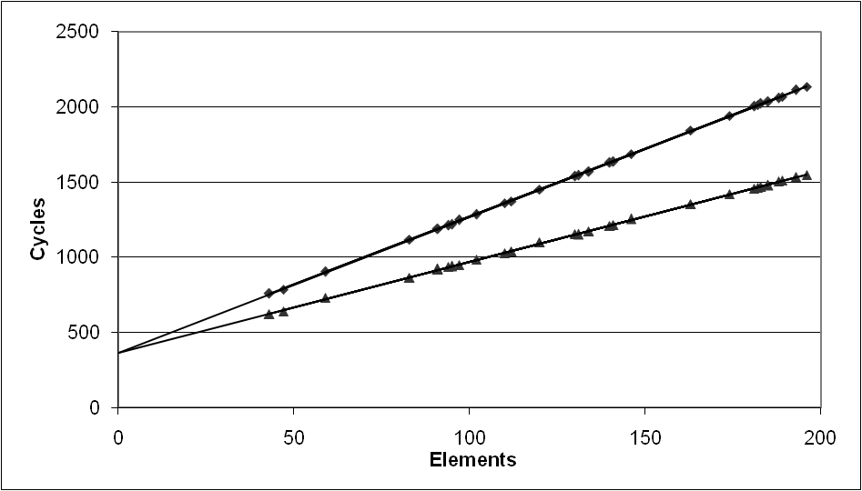
Cycles Per Element (CPE)
Convenient way to express performance of program that operates on vectors or lists
Length = n
In our case: CPE = cycles per OP
T = CPE*n + Overhead
  CPE is slope of line
psum1
Slope = 9.0
psum2
Slope = 6.0

Slide 25
Benchmark Performance
void combine1(vec_ptr v, data_t *dest)
{
long int i;
*dest = IDENT;
for (i = 0; i < vec_length(v); i++) {
data_t val;
get_vec_element(v, i, &val);
*dest = *dest OP val;
}
}
Compute sum or product of vector elements
Method | Integer |  | Double FP
Operation | Add | Mult | Add | Mult
Combine1 unoptimized | 22.68 | 20.02 | 19.98 | 20.18
Combine1 –O1 | 10.12 | 10.12 | 10.17 | 11.14

Slide 26
Basic Optimizations
void combine4(vec_ptr v, data_t *dest)
{
long i;
long length = vec_length(v);
data_t *d = get_vec_start(v);
data_t t = IDENT;
for (i = 0; i < length; i++)
t = t OP d[i];
*dest = t;
}
Move vec_length out of loop
Avoid bounds check on each cycle
Accumulate in temporary

Slide 27
Effect of Basic Optimizations
void combine4(vec_ptr v, data_t *dest)
{
long i;
long length = vec_length(v);
data_t *d = get_vec_start(v);
data_t t = IDENT;
for (i = 0; i < length; i++)
t = t OP d[i];
*dest = t;
}
Method | Integer |  | Double FP
Operation | Add | Mult | Add | Mult
Combine1 –O1 | 10.12 | 10.12 | 10.17 | 11.14
Combine4 | 1.27 | 3.01 | 3.01 | 5.01
Eliminates sources of overhead in loop

Slide 28
Modern CPU Design
Instruction Control
Fetch
Control
Address
Instruction
Cache
Retirement
Unit
Register
File
Instruction
Decode
Instructions
Operations
Register Updates
Prediction OK?
Execution
Functional
Units
Branch
Arith
Arith
Arith
Load
Store
Operation Results
Addr.
Addr.
Data
Data
Data
Cache

Slide 29
Superscalar Processor
Definition: A superscalar processor can issue and execute multiple instructions in one cycle. The instructions are retrieved from a sequential instruction stream and are usually scheduled dynamically.
Benefit: without programming effort, superscalar processor can take advantage of the instruction level parallelism that most programs have
Most modern CPUs are superscalar.
Intel: since Pentium (1993)

Slide 30
Pipelined Functional Units
Stage 1
long mult_eg(long a, long b, long c) {
long p1 = a*b;
return p3;
}
long p2 = a*c;
long p3 = p1 * p2;
Stage 2
Stage 3
 | Time
 | 1 | 2 | 3 | 4 | 5 | 6 | 7
Stage 1 | a*b | a*c |  |  | p1*p2
Stage 2 |  | a*b | a*c |  |  | p1*p2
Stage 3 |  |  | a*b | a*c |  |  | p1*p2
  Divide computation into stages
  Pass partial computations from stage to stage
  Stage i can start on new computation once values passed to i+1
  E.g., complete 3 multiplications in 7 cycles, even though each requires 3 cycles

Slide 31
Haswell CPU
Multiple instructions can execute in parallel
  2 load, with address computation
  1 store, with address computation
  4 integer
  2 FP multiply
  1 FP add
  1 FP divide
Some instructions take > 1 cycle, but can be pipelined
  Instruction Latency Cycles/Issue
  Load / Store 4 1
  Integer Multiply 3 1
  Integer/Long Divide 3-30 3-30
  Single/Double FP Multiply 5 1
  Single/Double FP Add 3 1
  Single/Double FP Divide 3-15 3-15

Slide 32
x86-64 Compilation of Combine4
Inner Loop (Case: Integer Multiply)
.L519: # Loop:
imull (%rax,%rdx,4), %ecx # t = t * d[i]
addq $1, %rdx # i++
cmpq %rdx, %rbp # Compare length:i
jg .L519 # If >, goto Loop
Method | Integer |  | Double FP
Operation | Add | Mult | Add | Mult
Combine4 | 1.27 | 3.01 | 3.01 | 5.01
Latency Bound | 1.00 | 3.00 | 3.00 | 5.00

Slide 33
Translation Example(x86_32)
Version of Combine4
  Integer data, multiply operation
Translation of First Iteration
.L24: # Loop:
imull (%eax,%edx,4),%ecx # t *= data[i]
incl %edx # i++
cmpl %esi,%edx # i:length
jl .L24 # if < goto Loop
.L24:
imull (%eax,%edx,4),%ecx
incl %edx
cmpl %esi,%edx
jl .L24
load (%eax,%edx.0,4) ➔ t.1
imull t.1, %ecx.0 ➔ %ecx.1
incl %edx.0 ➔ %edx.1
cmpl %esi, %edx.1 ➔ cc.1
jl-taken cc.1

Slide 34
Translation Example #1
imull (%eax,%edx,4),%ecx
load (%eax,%edx.0,4) ➔ t.1
imull t.1, %ecx.0 ➔ %ecx.1
  Split into two operations
    load reads from memory to generate temporary result t.1
    Multiply operation just operates on registers
  Operands
    Register %eax does not change in loop. Values will be retrieved from register file during decoding
    Register %ecx changes on every iteration. Uniquely identify different versions as %ecx.0, %ecx.1, %ecx.2, …
      Register renaming
      Values passed directly from producer to consumers (bypass hardware)

Slide 35
Translation Example #2
incl %edx
incl %edx.0 ➔ %edx.1
  Register %edx changes on each iteration. Rename as %edx.0, %edx.1, %edx.2, …

Slide 36
Translation Example #3
cmpl %esi,%edx
cmpl %esi, %edx.1 ➔ cc.1
  Condition codes are treated similar to registers
  Assign tag to define connection between producer and consumer

Slide 37
Translation Example #4
jl .L24
jl-taken cc.1
  Instruction control unit determines destination of jump
  Predicts whether will be taken and target
  Starts fetching instruction at predicted destination
  Execution unit simply checks whether or not prediction was OK
  If not, it signals instruction control
    Instruction control then “invalidates” any operations generated from misfetched instructions
    Begins fetching and decoding instructions at correct target

Slide 38
Visualizing Operations
%edx.0
load (%eax,%edx,4) ➔ t.1
imull t.1, %ecx.0 ➔ %ecx.1
incl %edx.0 ➔ %edx.1
cmpl %esi, %edx.1 ➔ cc.1
jl-taken cc.1
load
incl
%edx.1
cmpl
cc.1
%ecx.0
jl
t.1
imull
Time
Operations
  Vertical position denotes time at which executed
    Cannot begin operation until operands available
  Height denotes latency
Operands
  Arcs shown only for operands that are passed within execution unit
%ecx.1

Slide 39
Visualizing Operations (cont.)
load (%eax,%edx,4) ➔ t.1
iaddl t.1, %ecx.0 ➔ %ecx.1
incl %edx.0 ➔ %edx.1
cmpl %esi, %edx.1 ➔ cc.1
jl-taken cc.1
%edx.0
load
load
incl
%edx.1
%ecx.i +1
cmpl
cc.1
%ecx.0
jl
Operations
  Same as before, except that add has latency of 1
Time
t.1
addl
%ecx.1

Slide 40
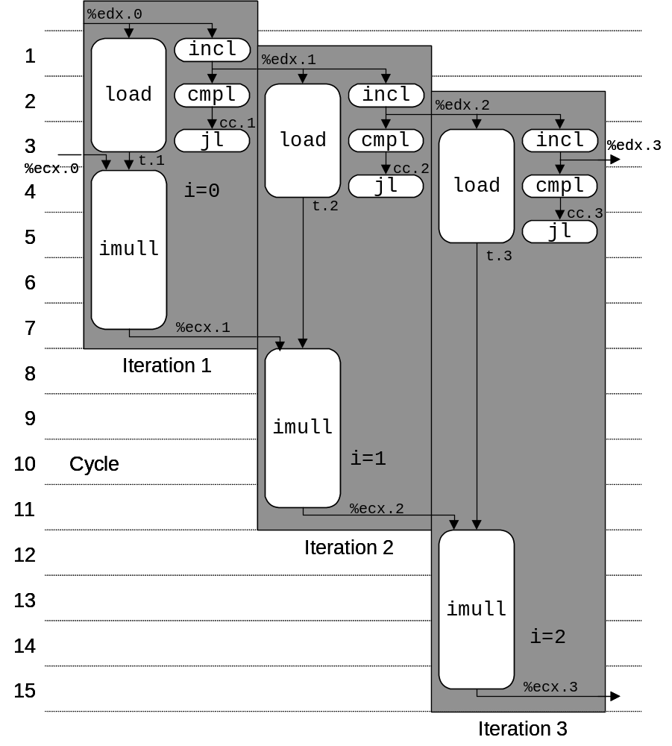
3 Iterations of Combining Product
Unlimited Resource Analysis
  Assume operation can start as soon as operands available
  Operations for multiple iterations overlap in time
Performance
  Limiting factor becomes latency of integer multiplier
  Gives CPE of 4.0

Slide 41
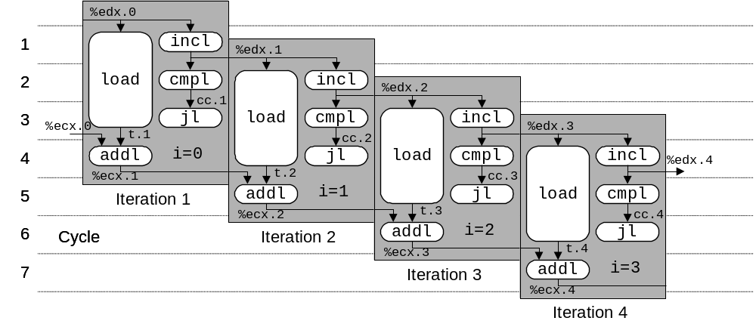
4 Iterations of Combining Sum
4 integer ops
Unlimited Resource Analysis
Performance
  Can begin a new iteration on each clock cycle
  Should give CPE of 1.0
  Would require executing 4 integer operations in parallel

Slide 42
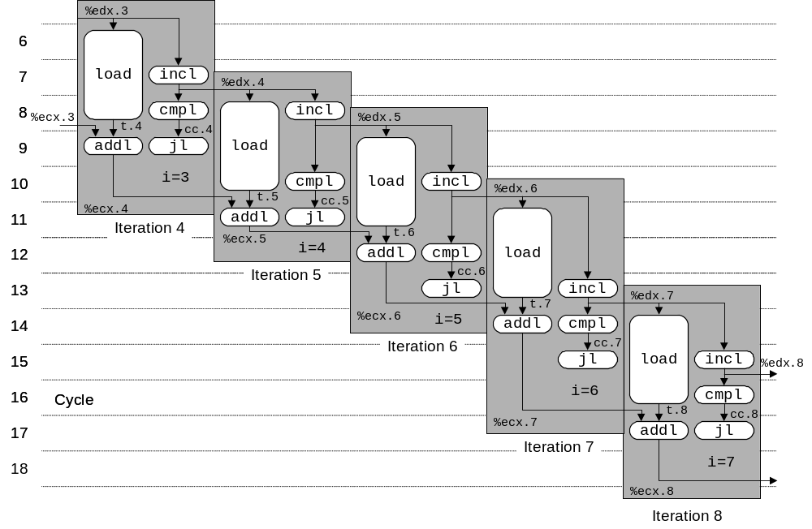
Combining Sum: Resource Constraints
  Only have two integer functional units
  Some operations delayed even though operands available
  Set priority based on program order
Performance
  Sustain CPE of 2.0

Slide 43
Combine4 = Serial Computation (OP = *)
Computation (length=8)
  ((((((((1 * d[0]) * d[1]) * d[2]) * d[3])
  * d[4]) * d[5]) * d[6]) * d[7])
Sequential dependence
  Performance: determined by latency of OP
1
d₀
*
d₁
*
d₂
*
d₃
*
d₄
*
d₅
*
d₆
*
d₇
*

Slide 44
Loop Unrolling (2x1)
void unroll2a_combine(vec_ptr v, data_t *dest)
{
long length = vec_length(v);
long limit = length-1;
data_t *d = get_vec_start(v);
data_t x = IDENT;
long i;
/* Combine 2 elements at a time */
for (i = 0; i < limit; i+=2) {
x = (x OP d[i]) OP d[i+1];
}
/* Finish any remaining elements */
for (; i < length; i++) {
x = x OP d[i];
}
*dest = x;
}
Perform 2x more useful work per iteration

Slide 45
Visualizing Unrolled Loop
  Loads can pipeline, since don’t have dependencies
  Only one set of loop control operations
%edx.0
load
addl
%edx.1
load
%ecx.i +1
cmpl
cc.1
load
jl
%ecx.0c
t.1a
addl
%ecx.1a
t.1b
Time
addl
%ecx.1b
t.1c
load (%eax,%edx.0,4) ➔ t.1a
iaddl t.1a, %ecx.0c ➔ %ecx.1a
load 4(%eax,%edx.0,4) ➔ t.1b
iaddl t.1b, %ecx.1a ➔ %ecx.1b
load 8(%eax,%edx.0,4) ➔ t.1c
iaddl t.1c, %ecx.1b ➔ %ecx.1c
iaddl $3,%edx.0 ➔ %edx.1
cmpl %esi, %edx.1 ➔ cc.1
jl-taken cc.1
addl
%ecx.1c

Slide 46
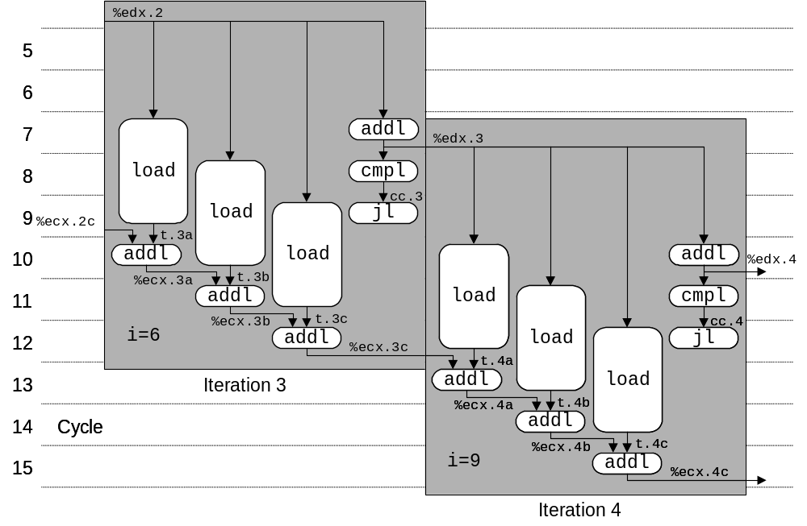
Executing with Loop Unrolling
  Predicted Performance
    Can complete iteration in 3 cycles
    Should give CPE of 1.0
  Measured Performance
    CPE of 1.33
    One iteration every 4 cycles

Slide 47
Effect of Loop Unrolling
Method | Integer |  | Double FP
Operation | Add | Mult | Add | Mult
Combine4 | 1.27 | 3.01 | 3.01 | 5.01
Unroll 2x1 | 1.01 | 3.01 | 3.01 | 5.01
Latency Bound | 1.00 | 3.00 | 3.00 | 5.00
Helps integer add
  Achieves latency bound
Others don’t improve. Why?
  Still sequential dependency
x = (x OP d[i]) OP d[i+1];

Slide 48
Loop Unrolling with Reassociation (2x1a)
void unroll2aa_combine(vec_ptr v, data_t *dest)
{
long length = vec_length(v);
long limit = length-1;
data_t *d = get_vec_start(v);
data_t x = IDENT;
long i;
/* Combine 2 elements at a time */
for (i = 0; i < limit; i+=2) {
x = x OP (d[i] OP d[i+1]);
}
/* Finish any remaining elements */
for (; i < length; i++) {
x = x OP d[i];
}
*dest = x;
}
Compare to before
x = (x OP d[i]) OP d[i+1];
Can this change the result of the computation?
Yes, for FP. Why?

Slide 49
Effect of Reassociation
Method | Integer |  | Double FP
Operation | Add | Mult | Add | Mult
Combine4 | 1.27 | 3.01 | 3.01 | 5.01
Unroll 2x1 | 1.01 | 3.01 | 3.01 | 5.01
Unroll 2x1a | 1.01 | 1.51 | 1.51 | 2.51
Latency Bound | 1.00 | 3.00 | 3.00 | 5.00
Throughput Bound | 0.50 | 1.00 | 1.00 | 0.50
Nearly 2x speedup for Int *, FP +, FP *
  Reason: Breaks sequential dependency
  Why is that? (next slide)
2 func. units for FP *
2 func. units for load
x = x OP (d[i] OP d[i+1]);
4 func. units for int +
2 func. units for load

Slide 50
Reassociated Computation
x = x OP (d[i] OP d[i+1]);
What changed:
  Ops in the next iteration can be started early (no dependency)
Overall Performance
  N elements, D cycles latency/op
  (N/2+1)*D cycles:
  CPE = D/2
d₀
d₁
*
d₂
d₃
1
*
d₄
d₅
*
*
d₆
d₇
*
*
*
*

Slide 51
Loop Unrolling with Separate Accumulators (2x2)
void unroll2a_combine(vec_ptr v, data_t *dest)
{
long length = vec_length(v);
long limit = length-1;
data_t *d = get_vec_start(v);
data_t x0 = IDENT;
data_t x1 = IDENT;
long i;
/* Combine 2 elements at a time */
for (i = 0; i < limit; i+=2) {
x0 = x0 OP d[i];
x1 = x1 OP d[i+1];
}
/* Finish any remaining elements */
for (; i < length; i++) {
x0 = x0 OP d[i];
}
*dest = x0 OP x1;
}
Different form of reassociation

Slide 52
Visualizing Parallel Loop
  Two multiplies within loop no longer have data depency
  Allows them to pipeline
%edx.0
load
addl
%edx.1
load
cmpl
cc.1
%ecx.0
jl
t.1a
%ebx.0
imull
t.1b
imull
Time
load (%eax,%edx.0,4) ➔ t.1a
imull t.1a, %ecx.0 ➔ %ecx.1
load 4(%eax,%edx.0,4) ➔ t.1b
imull t.1b, %ebx.0 ➔ %ebx.1
iaddl $2,%edx.0 ➔ %edx.1
cmpl %esi, %edx.1 ➔ cc.1
jl-taken cc.1
%ecx.1
%ebx.1

Slide 53
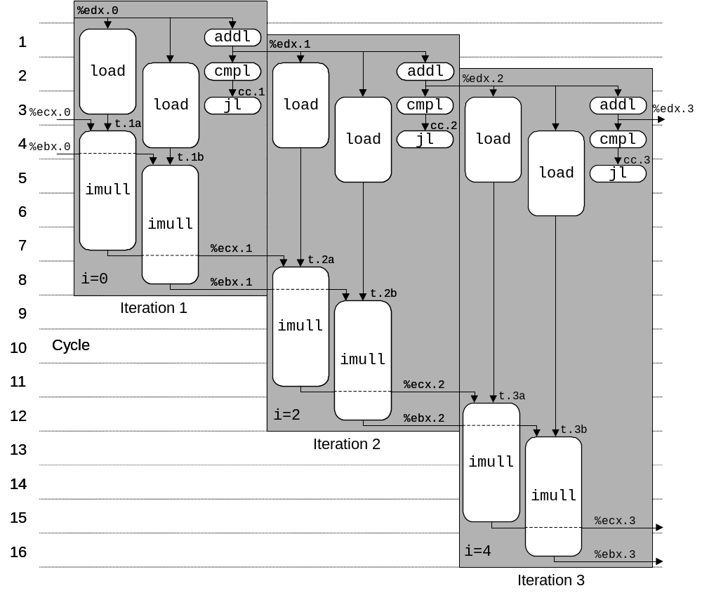
Executing with Parallel Loop
  Predicted Performance
    Can keep 4-cycle multiplier busy performing two simultaneous multiplications
    Gives CPE of 2.0

Slide 54
Effect of Separate Accumulators
Method | Integer |  | Double FP
Operation | Add | Mult | Add | Mult
Combine4 | 1.27 | 3.01 | 3.01 | 5.01
Unroll 2x1 | 1.01 | 3.01 | 3.01 | 5.01
Unroll 2x1a | 1.01 | 1.51 | 1.51 | 2.51
Unroll 2x2 | 0.81 | 1.51 | 1.51 | 2.51
Latency Bound | 1.00 | 3.00 | 3.00 | 5.00
Throughput Bound | 0.50 | 1.00 | 1.00 | 0.50
Int + makes use of two load units
2x speedup (over unroll2) for Int *, FP +, FP *
x0 = x0 OP d[i];
x1 = x1 OP d[i+1];

Slide 55
Separate Accumulators
x0 = x0 OP d[i];
x1 = x1 OP d[i+1];
What changed:
  Two independent “streams” of operations
Overall Performance
  N elements, D cycles latency/op
  Should be (N/2+1)*D cycles:
  CPE = D/2
  CPE matches prediction!
1
d₀
1
d₁
*
d₂
*
d₃
*
d₄
*
d₅
*
d₆
*
d₇
*
*
What Now?
*

Slide 56
Unrolling & Accumulating
Idea
  Can unroll to any degree L
  Can accumulate K results in parallel
  L must be multiple of K
Limitations
  Diminishing returns
    Cannot go beyond throughput limitations of execution units
  Large overhead for short lengths
    Finish off iterations sequentially

Slide 57
Unrolling & Accumulating: Double *
Case
  Intel Haswell
  Double FP Multiplication
  Latency bound: 5.00. Throughput bound: 0.50
FP * | Unrolling Factor L
K | 1 | 2 | 3 | 4 | 6 | 8 | 10 | 12
1 | 5.01 | 5.01 | 5.01 | 5.01 | 5.01 | 5.01 | 5.01
2 |  | 2.51 |  | 2.51 |  | 2.51
3 |  |  | 1.67
4 |  |  |  | 1.25 |  | 1.26
6 |  |  |  |  | 0.84 |  |  | 0.88
8 |  |  |  |  |  | 0.63
10 |  |  |  |  |  |  | 0.51
12 |  |  |  |  |  |  |  | 0.52
Accumulators

Slide 58
Unrolling & Accumulating: Int +
Case
  Intel Haswell
  Integer addition
  Latency bound: 1.00. Throughput bound: 0.50
FP * | Unrolling Factor L
K | 1 | 2 | 3 | 4 | 6 | 8 | 10 | 12
1 | 1.27 | 1.01 | 1.01 | 1.01 | 1.01 | 1.01 | 1.01
2 |  | 0.81 |  | 0.69 |  | 0.54
3 |  |  | 0.74
4 |  |  |  | 0.69 |  | 1.24
6 |  |  |  |  | 0.56 |  |  | 0.56
8 |  |  |  |  |  | 0.54
10 |  |  |  |  |  |  | 0.54
12 |  |  |  |  |  |  |  | 0.56
Accumulators

Slide 59
Achievable Performance
Method | Integer |  | Double FP
Operation | Add | Mult | Add | Mult
Best | 0.54 | 1.01 | 1.01 | 0.52
Latency Bound | 1.00 | 3.00 | 3.00 | 5.00
Throughput Bound | 0.50 | 1.00 | 1.00 | 0.50
Limited only by throughput of functional units
Up to 42X improvement over original, unoptimized code

Slide 60
Programming with AVX2
YMM Registers
  16 total, each 32 bytes
  32 single-byte integers
  16 16-bit integers
  8 32-bit integers
  8 single-precision floats
  4 double-precision floats
  1 single-precision float
  1 double-precision float

Slide 61
SIMD Operations
  SIMD Operations: Single Precision
  SIMD Operations: Double Precision
vaddsd %ymm0, %ymm1, %ymm1
%ymm0
+
+
+
+
+
+
+
+
%ymm1
vaddpd %ymm0, %ymm1, %ymm1
%ymm0
+
+
+
+
%ymm1

Slide 62
Using Vector Instructions
Method | Integer |  | Double FP
Operation | Add | Mult | Add | Mult
Scalar Best | 0.54 | 1.01 | 1.01 | 0.52
Vector Best | 0.06 | 0.24 | 0.25 | 0.16
Latency Bound | 0.50 | 3.00 | 3.00 | 5.00
Throughput Bound | 0.50 | 1.00 | 1.00 | 0.50
Vec Throughput Bound | 0.06 | 0.12 | 0.25 | 0.12
Make use of AVX Instructions
  Parallel operations on multiple data elements
  See Web Aside OPT:SIMD on CS:APP web page

Slide 63
What About Branches?
Challenge
  Instruction Control Unit must work well ahead of Execution Unit
  to generate enough operations to keep EU busy
  When encounters conditional branch, cannot reliably determine where to continue fetching
404663: mov $0x0,%eax
404668: cmp (%rdi),%rsi
40466b: jge 404685
40466d: mov 0x8(%rdi),%rax
. . .
404685: repz retq
Executing
How to continue?

Slide 64
Modern CPU Design
Instruction Control
Fetch
Control
Address
Instruction
Cache
Retirement
Unit
Register
File
Instruction
Decode
Instructions
Operations
Register Updates
Prediction OK?
Execution
Functional
Units
Branch
Arith
Arith
Arith
Load
Store
Operation Results
Addr.
Addr.
Data
Data
Data
Cache

Slide 65
Branch Outcomes
  When encounter conditional branch, cannot determine where to continue fetching
    Branch Taken: Transfer control to branch target
    Branch Not-Taken: Continue with next instruction in sequence
  Cannot resolve until outcome determined by branch/integer unit
404663: mov $0x0,%eax
404668: cmp (%rdi),%rsi
40466b: jge 404685
40466d: mov 0x8(%rdi),%rax
. . .
404685: repz retq
Branch Not-Taken
Branch Taken

Slide 66
Branch Prediction
Idea
  Guess which way branch will go
  Begin executing instructions at predicted position
    But don’t actually modify register or memory data
404663: mov $0x0,%eax
404668: cmp (%rdi),%rsi
40466b: jge 404685
40466d: mov 0x8(%rdi),%rax
. . .
404685: repz retq
Predict Taken
Begin
Execution

Slide 67
Branch Prediction Through Loop
401029: vmulsd (%rdx),%xmm0,%xmm0
40102d: add $0x8,%rdx
401031: cmp %rax,%rdx
401034: jne 401029
Assume
vector length = 100
i = 98
Predict Taken (OK)
401029: vmulsd (%rdx),%xmm0,%xmm0
40102d: add $0x8,%rdx
401031: cmp %rax,%rdx
401034: jne 401029
i = 99
Predict Taken
(Oops)
401029: vmulsd (%rdx),%xmm0,%xmm0
40102d: add $0x8,%rdx
401031: cmp %rax,%rdx
401034: jne 401029
Read invalid location
Executed
i = 100
401029: vmulsd (%rdx),%xmm0,%xmm0
40102d: add $0x8,%rdx
401031: cmp %rax,%rdx
401034: jne 401029
Fetched
i = 101

Slide 68
Branch Misprediction Invalidation
401029: vmulsd (%rdx),%xmm0,%xmm0
40102d: add $0x8,%rdx
401031: cmp %rax,%rdx
401034: jne 401029
Assume
vector length = 100
i = 98
Predict Taken (OK)
401029: vmulsd (%rdx),%xmm0,%xmm0
40102d: add $0x8,%rdx
401031: cmp %rax,%rdx
401034: jne 401029
i = 99
Predict Taken
(Oops)
401029: vmulsd (%rdx),%xmm0,%xmm0
40102d: add $0x8,%rdx
401031: cmp %rax,%rdx
401034: jne 401029
i = 100
Invalidate
401029: vmulsd (%rdx),%xmm0,%xmm0
40102d: add $0x8,%rdx
401031: cmp %rax,%rdx
401034: jne 401029
i = 101

Slide 69
Branch Misprediction Recovery
401029: vmulsd (%rdx),%xmm0,%xmm0
40102d: add $0x8,%rdx
401031: cmp %rax,%rdx
401034: jne 401029
401036: jmp 401040
. . .
401040: vmovsd %xmm0,(%r12)
i = 99
Definitely not taken
Reload
Pipeline
Performance Cost
  Multiple clock cycles on modern processor
  Can be a major performance limiter

Slide 70
Important Tools
Observation
  Generating assembly code
    Lets you see what optimizations compiler can make
    Understand capabilities/limitations of particular compiler
Measurement
  Accurately compute time taken by code
    Most modern machines have built in cycle counters
    Using them to get reliable measurements is tricky
  Profile procedure calling frequencies
    Unix tool gprof

Slide 71
Code Profiling Example
Task
  Count word frequencies in text document
  Produce sorted list of words from most frequent to least
Steps
  Convert strings to lowercase
  Apply hash function
  Read words and insert into hash table
    Mostly list operations
    Maintain counter for each unique word
  Sort results
Data Set
  Collected works of Shakespeare
  946,596 total words, 26,596 unique
  Initial implementation: 9.2 seconds
  Shakespeare’s
  most frequent words
29,801 | the
27,529 | and
21,029 | I
20,957 | to
18,514 | of
15,370 | a
14010 | you
12,936 | my
11,722 | in
11,519 | that
Notes:
n-gram

Slide 72
Code Profiling
Augment Executable Program with Timing Functions
  Computes (approximate) amount of time spent in each function
  Time computation method
    Periodically (~ every 10ms) interrupt program
    Determine what function is currently executing
    Increment its timer by interval (e.g., 10ms)
  Also maintains counter for each function indicating number of times called
Using
  gcc –O2 –pg prog.c –o prog
  ./prog
    Executes in normal fashion, but also generates file gmon.out
  gprof prog
    Generates profile information based on gmon.out

Slide 73
Profiling Results
% cumulative self self total
time seconds seconds calls ms/call ms/call name
86.60 8.21 8.21 1 8210.00 8210.00 sort_words
5.80 8.76 0.55 946596 0.00 0.00 lower1
4.75 9.21 0.45 946596 0.00 0.00 find_ele_rec
1.27 9.33 0.12 946596 0.00 0.00 h_add
Call Statistics
  Number of calls and cumulative time for each function
Performance Limiter
  Using inefficient sorting algorithm
  Single call uses 87% of CPU time

Slide 74
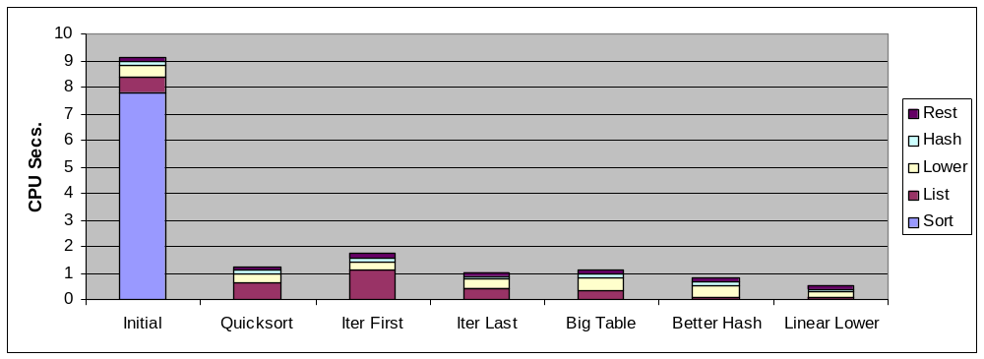
Code Optimizations
  First step: Use more efficient sorting function
  Library function qsort

Slide 75
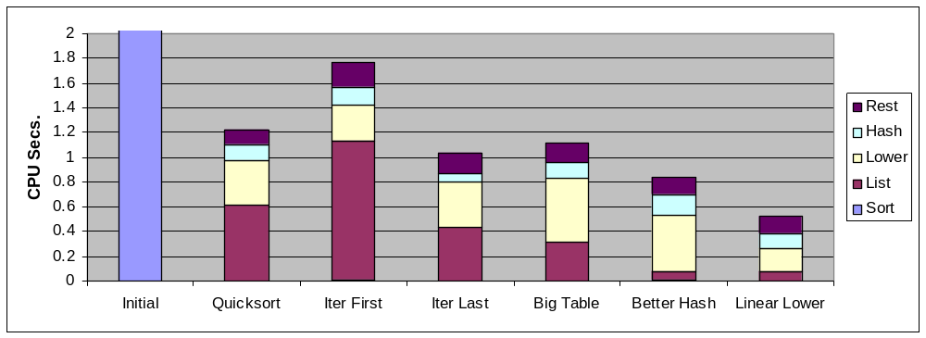
Further Optimizations
  Iter first: Use iterative function to insert elements into linked list
    Causes code to slow down
  Iter last: Iterative function, places new entry at end of list
    Tend to place most common words at front of list
  Big table: Increase number of hash buckets
  Better hash: Use more sophisticated hash function
  Linear lower: Move strlen out of loop

Slide 76
Profiling Observations
Benefits
  Helps identify performance bottlenecks
  Especially useful when have complex system with many components
Limitations
  Only shows performance for data tested
  E.g., linear lower did not show big gain, since words are short
    Quadratic inefficiency could remain lurking in code
  Timing mechanism fairly crude
    Only works for programs that run for > 3 seconds

Slide 77
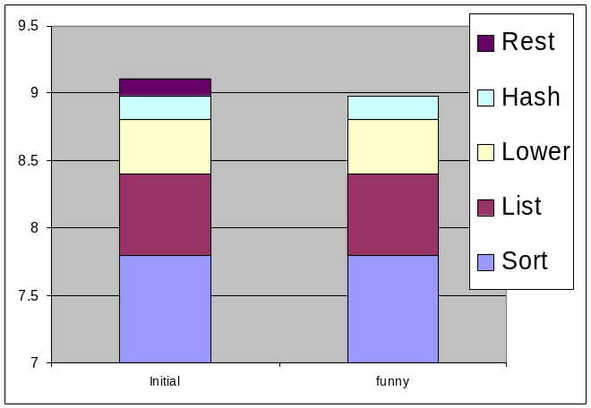
How Much Effort Should we Expend?
Amdahl’s Law:
Overall performance improvement is a combination
  How much we sped up a piece of the system
  How important that piece is!
Example, suppose Chose to optimize “rest” & you succeed! It goes to ZERO seconds!

Slide 78
How Much Effort Should we Expend?
Amdahl’s Law:
Overall performance improvement is a combination
  How much we sped up a piece of the system
  How important that piece is!
Example, suppose Chose to optimize “rest” & you succeed! It goes to ZERO seconds!
Amdahl’s Law
  Total time = (1-α)T + αT
  Component optimizing takes αT time.
  Improvement is factor of k, then:
  T_{new} = T_{old}[(1-α) + α/k]
  Speedup = T_{old}/T_{new} = 1/ [(1-α) + α/k]
  Maximum Achievable Speedup (k = ∞) = 1/(1-α)

Slide 79
Getting High Performance
Good compiler and flags
Don’t do anything stupid
  Watch out for hidden algorithmic inefficiencies
  Write compiler-friendly code
    Watch out for optimization blockers:
    procedure calls & memory references
  Look carefully at innermost loops (where most work is done)
Tune code for machine
  Exploit instruction-level parallelism
  Avoid unpredictable branches
  Make code cache friendly (Covered later in course)

